Slide 1
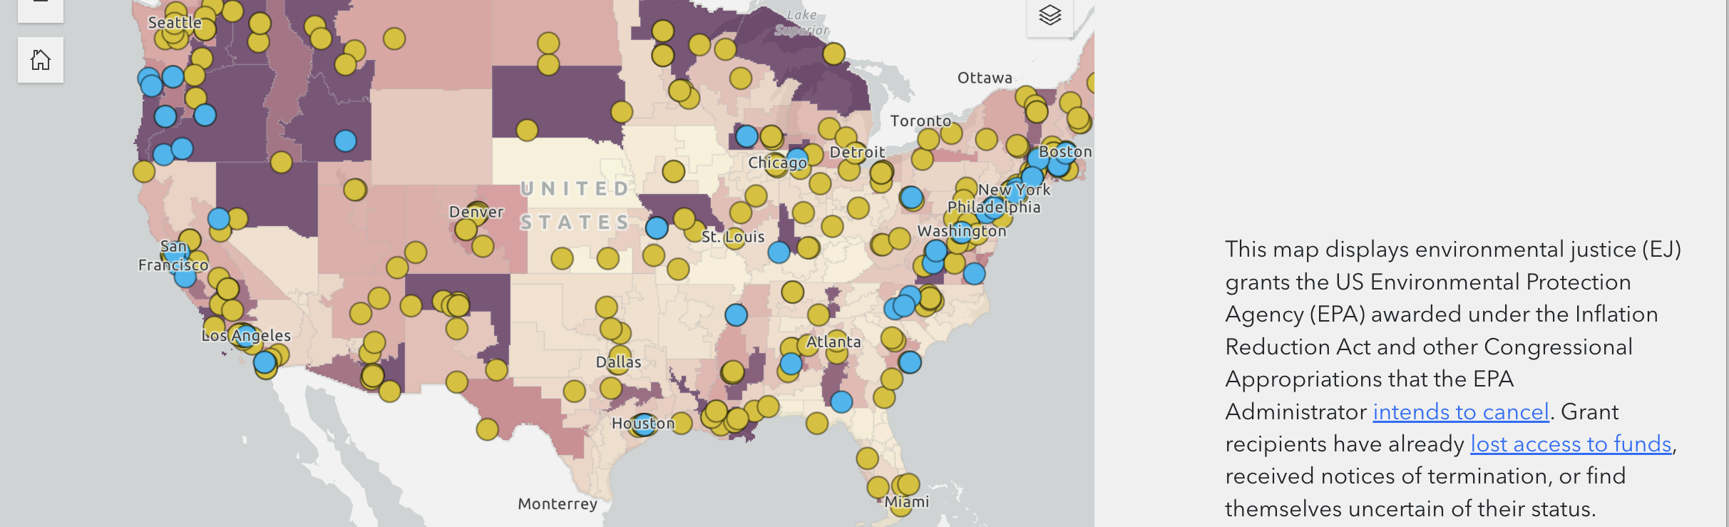
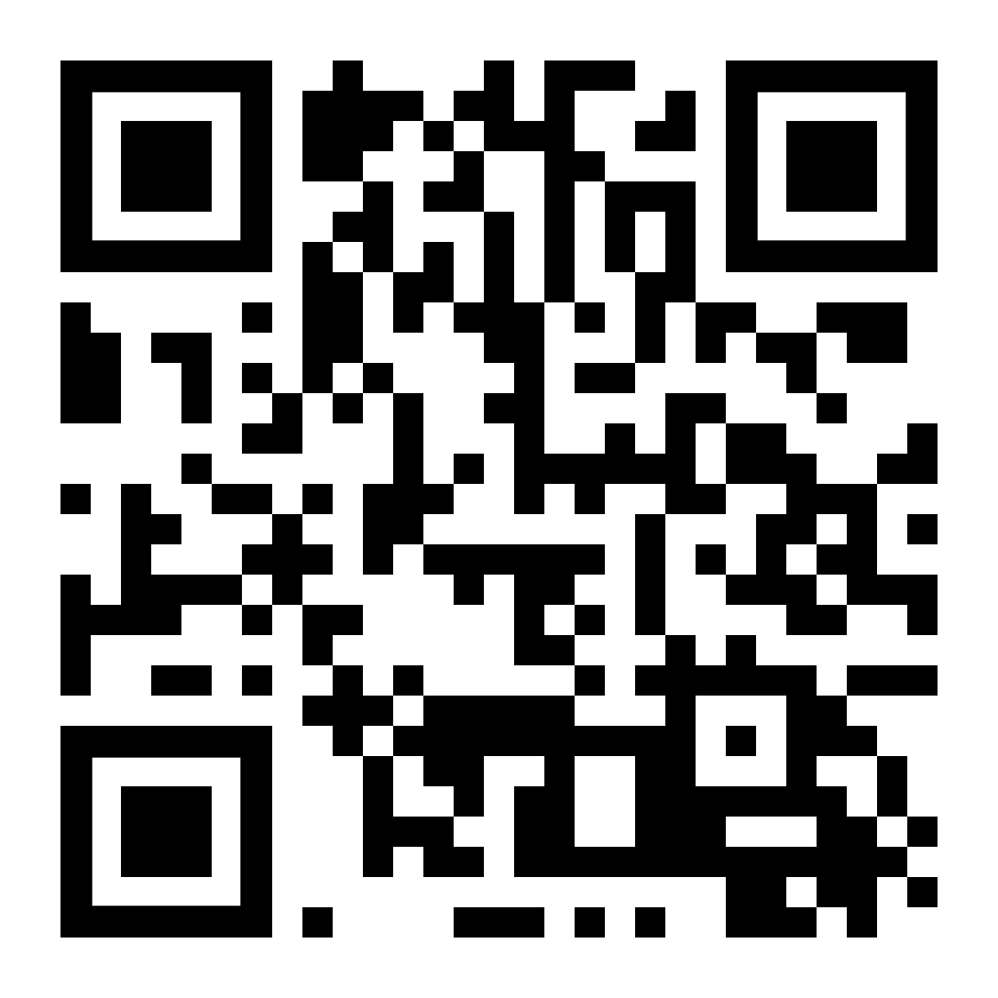
Why Quantify Environmental Justice?
Teaching Data, Power, and Equity
USSEE Workshop
Ashley Lowe Mackenzie
University of Hawaii at Manoa
https://github.com/loweas/ussee

Slide 2
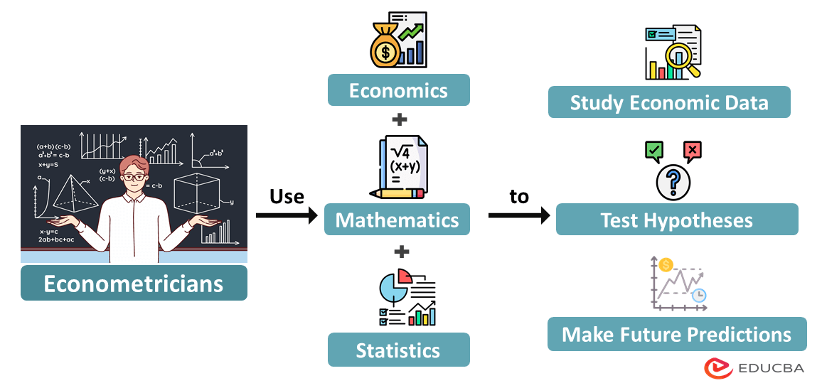
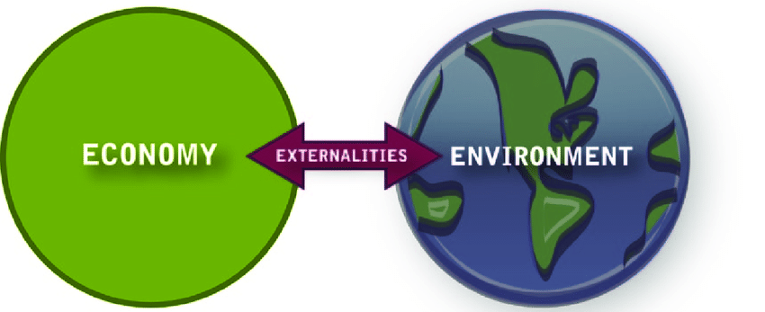
Classroom Framing
Environmental Economics
Econometrics
Empirical studies economic effects of environmental policies, including costs/benefits of policies to deal with air pollution, water quality, toxic substances, solid waste, and global warming
Statistic and Econometrics are powerful tool to see how the economic theory holds up with real data providing a point estimate

Slide 3
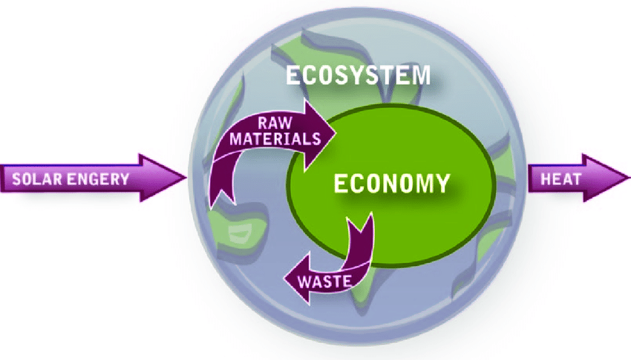
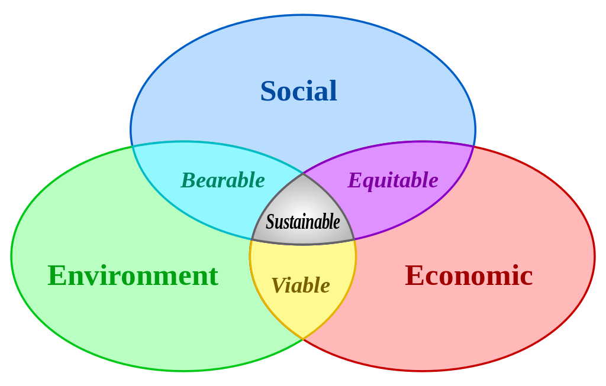
Classroom Framing
Ecological Economics
Social Environmental Economics
Treats economy as a subsystem of Earth's larger ecosystem, and by emphasizing the preservation of natural capital/ biosphere limitation
Framing the class with interconnected links between social policy, economics and environmental outcomes

Slide 4
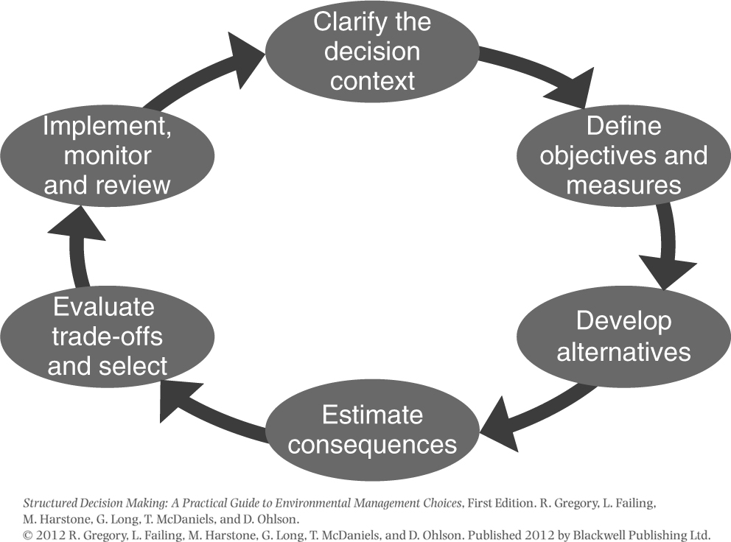
Structured decision making
Clarify the decision context
Define the objectives
Develop alternatives
Estimate Consequences
Trade offs
Monoitor (Adaptive Management)

Slide 5
Building Framework w/ Quantitative Focus (Pedagogical Strategy)
Course of a Class – Research Project Either Group or Individual
Step | Task | Teaching Goal
Define Scope & Decision Makers (Week 1-2) | Pick a local, region, population, or issue, Identifying communities impacted | Center justice in a real-world, place-based context. Who is included? Build Decision maker Matrix
2. Performance Metrics (Week 3) | Environmental (PM2.5, proximity to polluter, water quality), Social/economic (e.g., income, race, tribal land) | Unpack assumptions: what “counts” as harm or vulnerability? What does the number mean?
3. Data (Week 4-5) | Assign students to find datasets: EPA, ACS, community science, mobile data, state | Exploring data analytics
4. Identification/Weights (Week 6) | Structured Decision Making: priority/value weighting, expert elicitation | Show how weighting reflects justice trade-offs
5. Build Model (Week 7-8) | Use Excel or GIS, expert elicitation, value to build a simple additive or weighted index | Practice applied skills
6. Reflect Present (Final) | Present: what did your index capture and what did it miss? | Reinforce critical thinking about measurement ethics

Slide 6
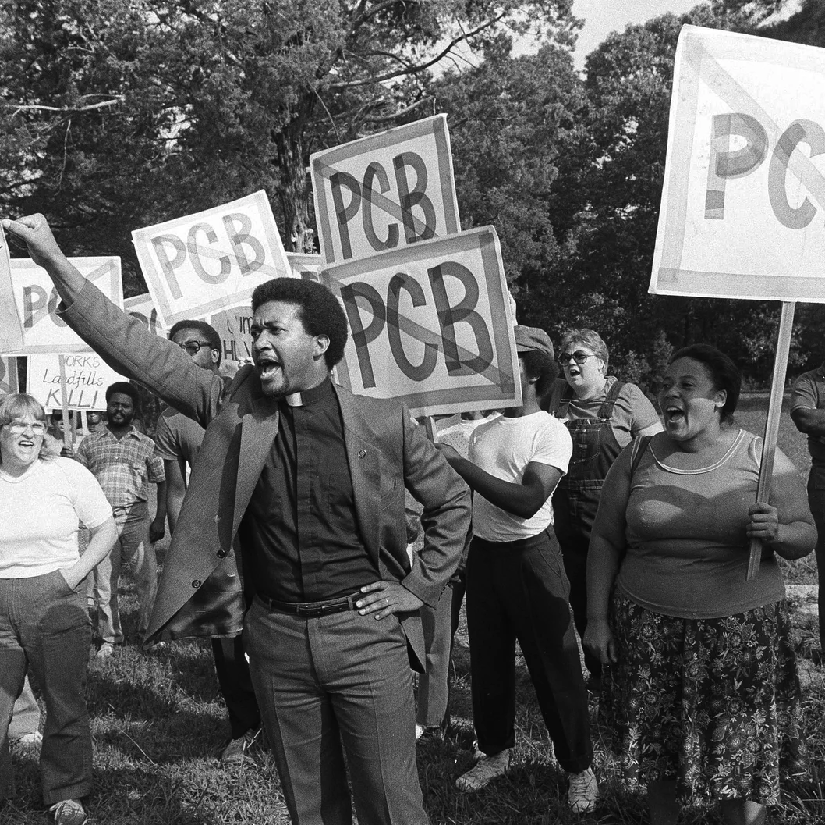
Example EJ
Provide Historical Context, policy example, incorporating social, economic, environmental impacts
Rev. Ben Chavis, right, raises his fist as fellow protesters are taken to jail at the Warren County PCB landfill near Afton, N.C., on Sept. 16, 1982.
Greg Gibson/AP / NPR

Slide 7

Background in Environmental Justice Movement
Pre-1976 : Companies could produce polychlorinated biphenyls (PCBs)
PCBs found to be toxicity and could impact health & environment.
1976: US passes Toxic Substances Control Act regulates/banned PCBs

Slide 8
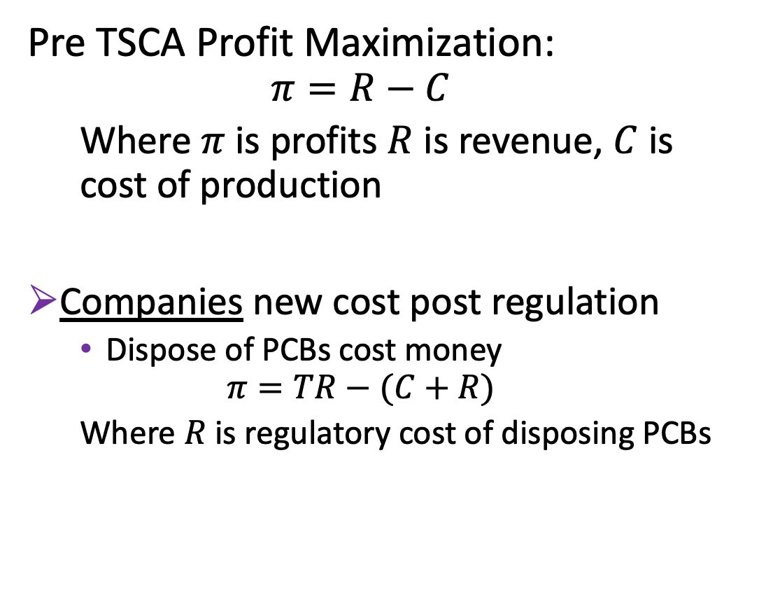
Traditional Economics
Pre TSCA Profit Maximization:
$$π=R−C$$
Where $π$ is profits $R$ is revenue, $C$ is cost of production
Companies new cost post regulation
Dispose of PCBs cost money
$$π=TR−(C+R)$$
Where $R$ is regulatory cost of disposing PCBs

Slide 9
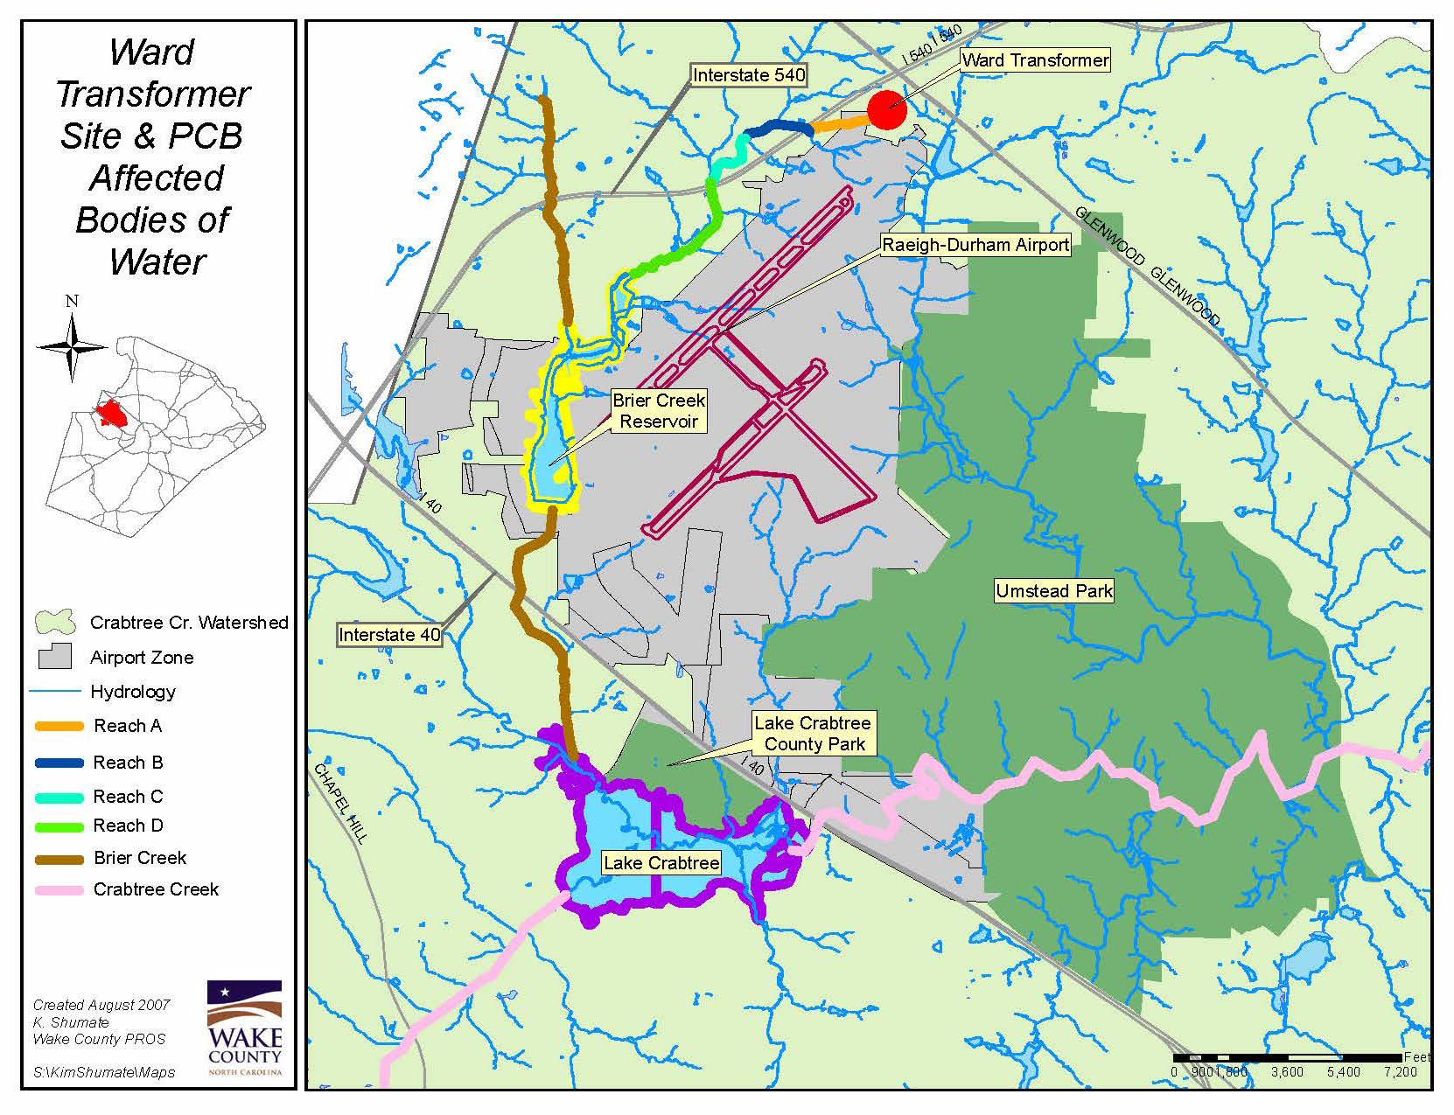
Background in EJ Movement
Ward Transformer Company
if they illegal dump and don’t get caught R=0
But where?
Fort Braggs impact range– poor absorption & too sandy for truck
Rural roads along 14 counties in North Carolina

Slide 10
Background in Environmental Justice
90 Potential Sites across North Carolina
Chatham County
27% Black
7% Below Poverty Line
Warren County
60% Black
25% Below Poverty line
Low groundwater table
Social Planner Problem
Which Landfill to Dump Waste?
14 Counties reported oily substance sprayed along NC Highway 58 (1978) leading to:
Prosecuted Ward Transformer (jail time)
Created new social problem:
Gather contaminated soil & proper disposal.
Who did they choose?

Slide 11
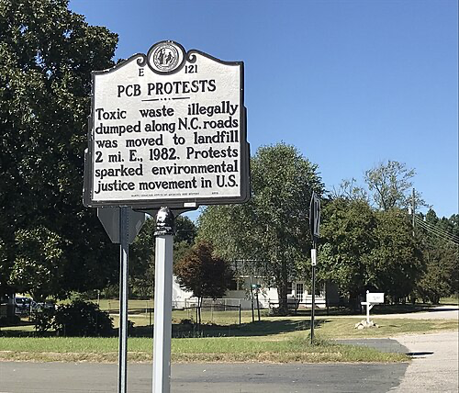
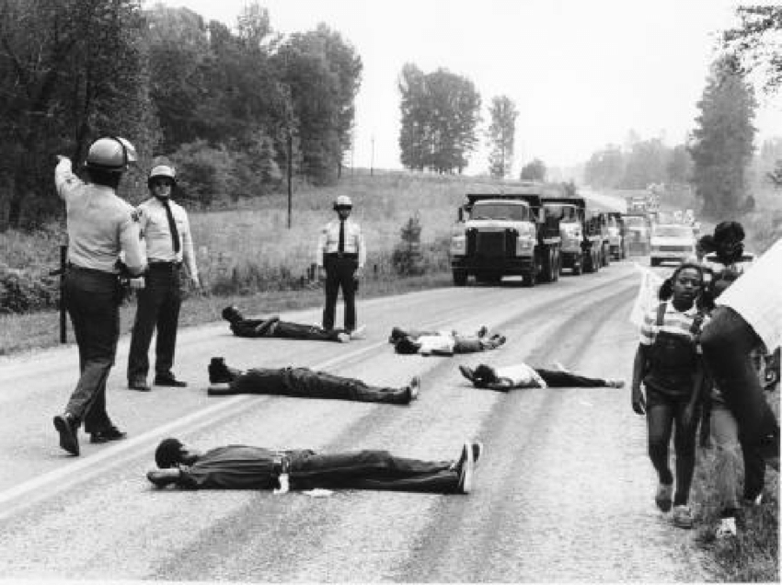
Environmental Justice Movement
NC Highways Historical Marker for PCB landfill protests in Afton, North Carolina –Creative Commons
Warren County
6-week, non-violent protest laying down in front of dump trucks.
550 Arrests
1st arrest in nation of protestors in the act of stopping pollution
Environmental justice: protests against dumping PCB contaminated soil in an African-American community, Warren County, North Carolina, 1982. Source: Jenny Labalme, 1987

Slide 12
Explore Drivers:
Site Choice
Chatham County
Warren County
Privately Owned
Publicly Owned
Open to Public Discussion
Strong opposition
Available for state purchase even w/ public Strong opposition
Demographics
Economic systems
Governmental and Policy objectives.
Other Examples:
Love Canal - Superfund
Flint Water Crisis
Cancer Alley

Slide 13
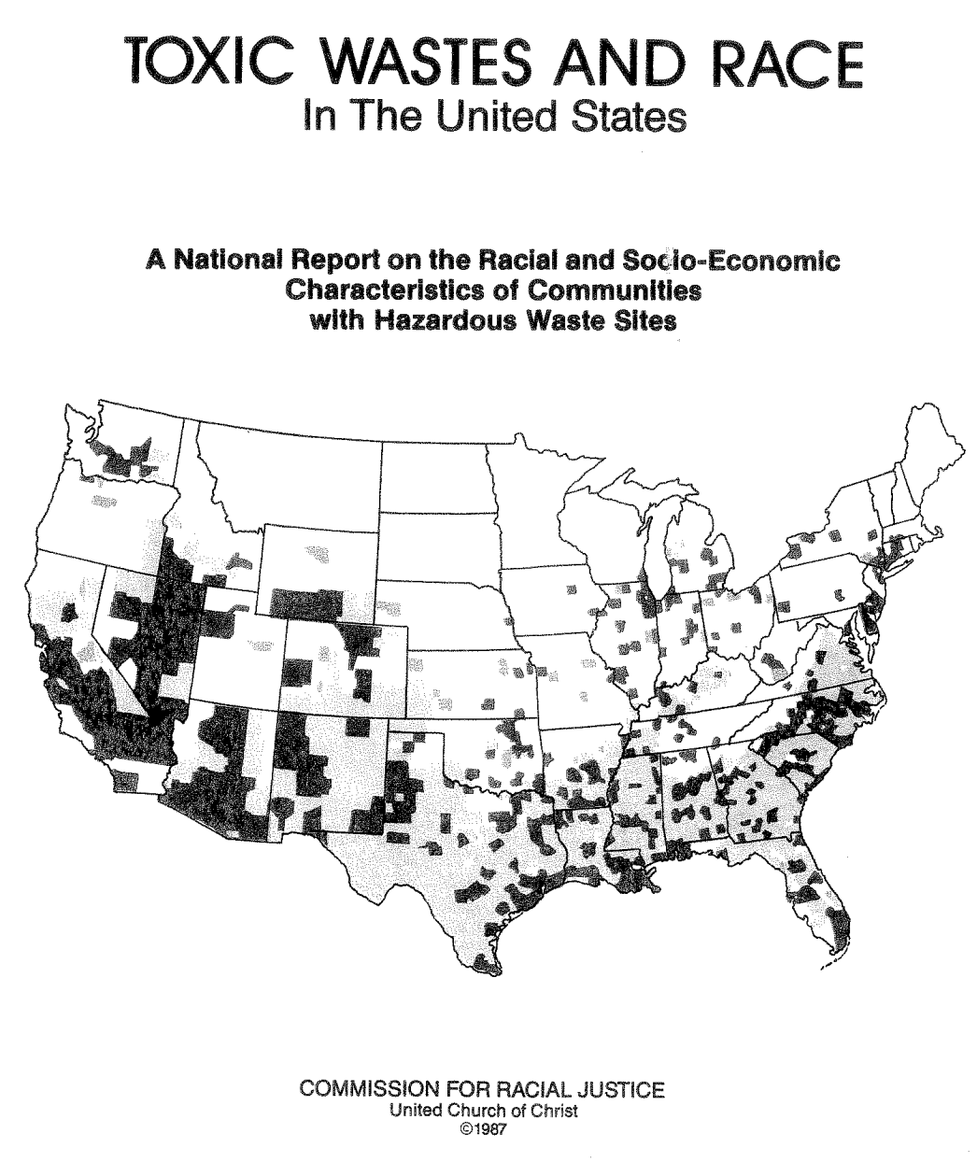
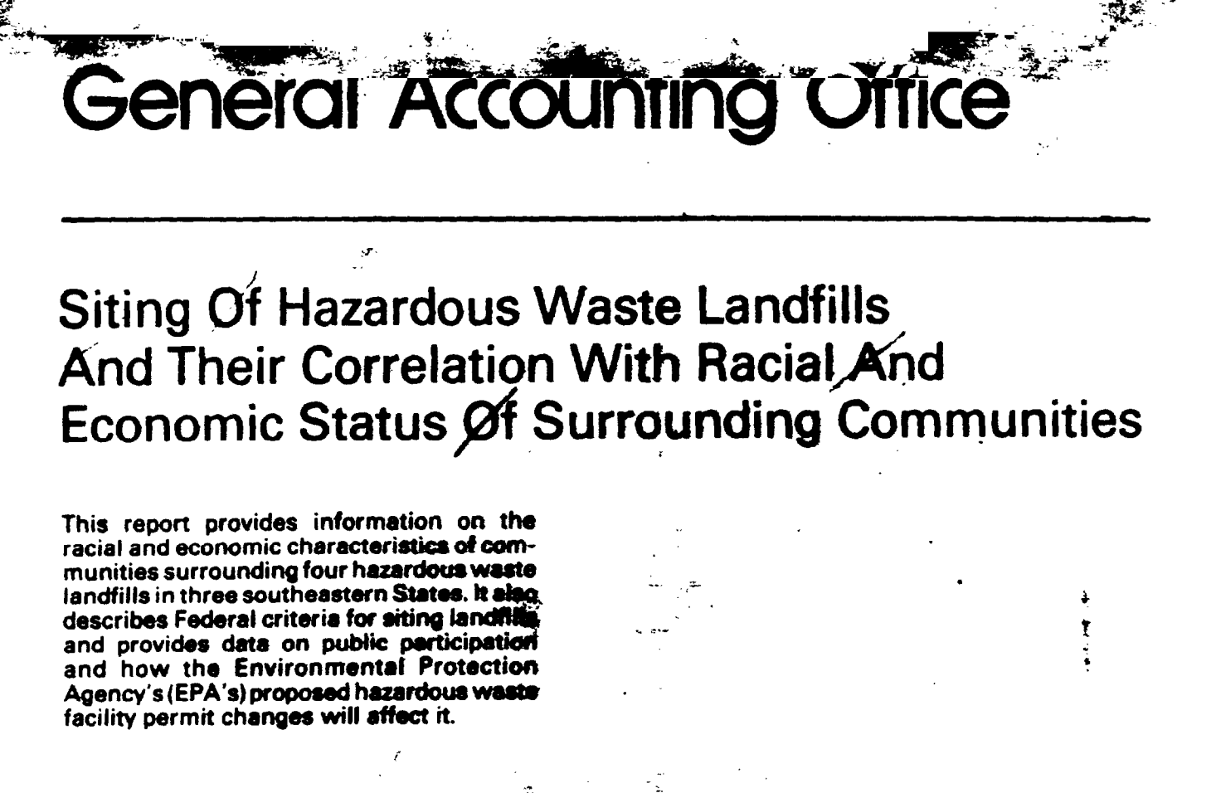
Environmental Justice Movement
Spawned research evidence-based environmental hazards & social-economic indicators.
Across disciplines law, sociology, public policy, geoscience and economics
Robust Correlation between hazards and soci-economic indicators
Chavis and Lee 1987
GAO 1983

Slide 14
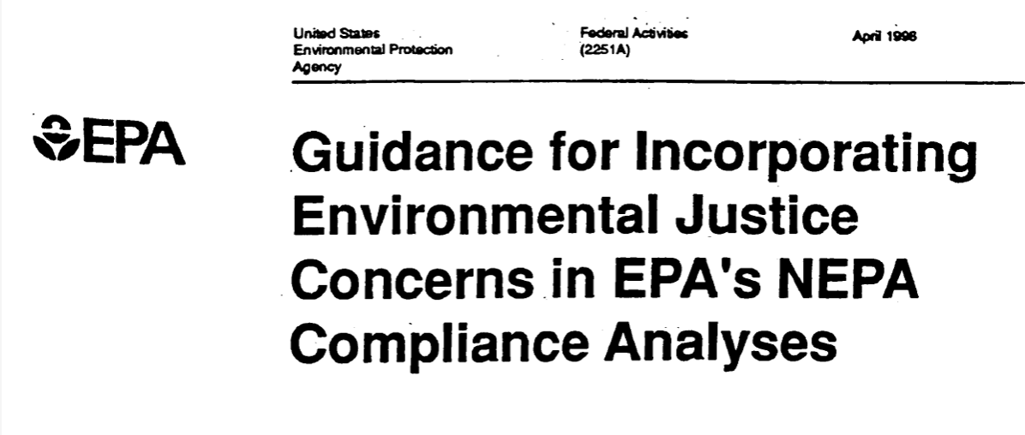
What is Environmental Justice?
May 2018
EPA defined (1998):
"fair treatment and meaningful involvement of all people regardless of race, color, national origin, or income with respect to the development, implementation, and enforcement of environmental laws, regulations, and policies. Fair treatment means that no group of people, including racial, ethnic, or socioeconomic group should bear a disproportionate share of the negative environmental consequences resulting from industrial, municipal, and commercial operations or the execution of federal, state, local, and tribal programs and policies.”

Slide 15
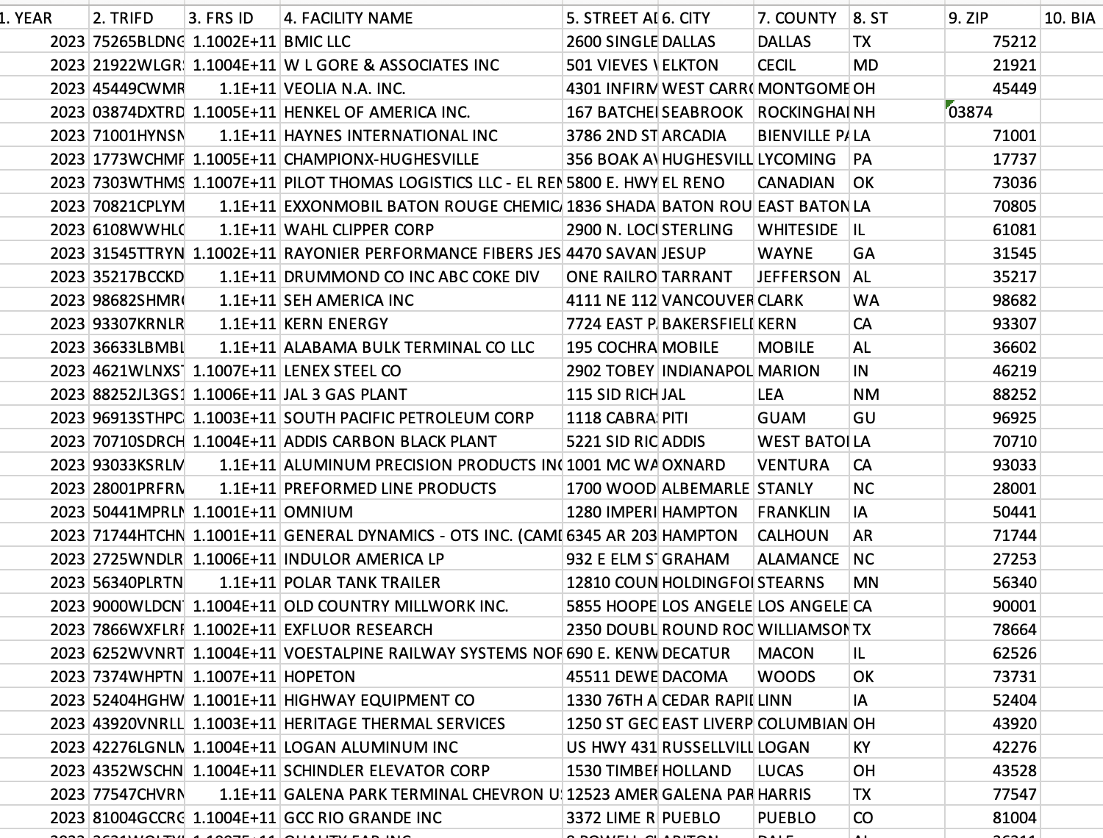
DATA IS COOL!
Much of class is focused on trying to make data cool! Large push on finding real datasets and GIS visualization and asking the question:
What does the number capture?

Slide 16
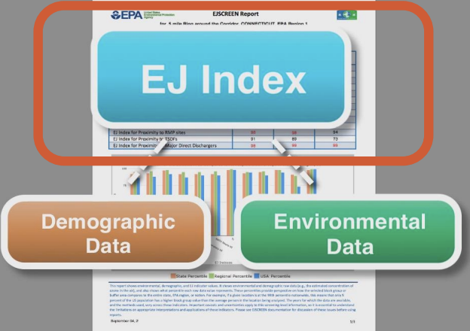
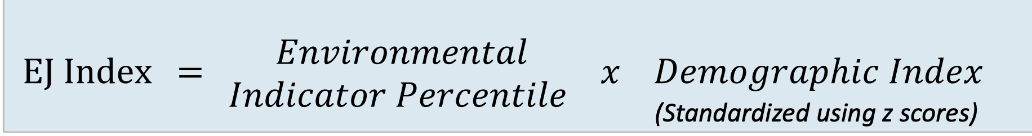
EPA Created EJ Screen – Environmental Justice Tool
Indexes helps identify areas that may have higher pollution burdens and vulnerable populations present
Where $z=\frac{x−μ}{σ}$ where x is value of block $μ$ is mean and $σ$ is the standard deviations

Slide 17
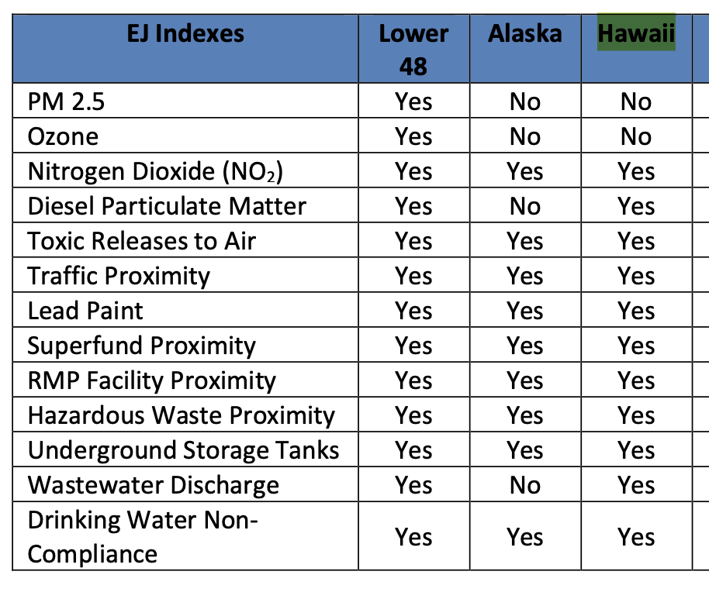
EJ Indexes to Identify Community
Environmental (13 indicators)
Socioeconomic (7 indicators)
13 EJ Indexes
13 Supplemental Indexes
Health (5 indicators)
Climate (5 indicators)
Critical Service Gaps (5 indicators)

Slide 18

Common Sentiment
I run into when teaching quantitative analysis with students in interdisciplinary department with many natural science students
This Photo by Unknown Author is licensed under CC BY

Slide 19
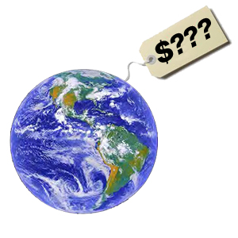
Why quantify it? – Students sometimes hesitant to quantify
Reveal Systemic Inequities
Inform Policy and Target Resources
Enable Legal and Regulatory Action
Track Progress (adaptive management)

Slide 20
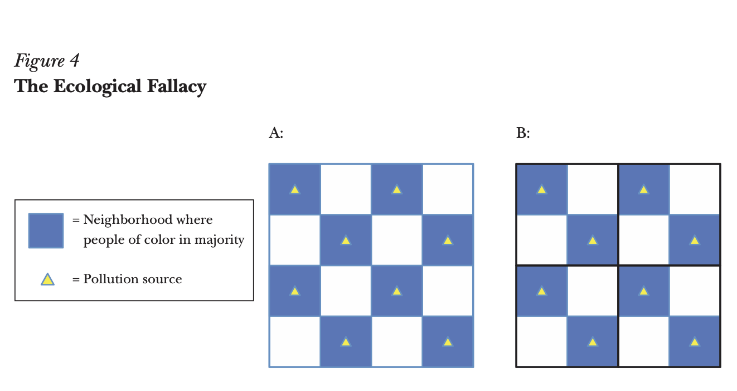
One my Main concerns
Space & Time largest conceptual challenges we face in human understanding.
Census block, tract, zip, grid
Exposure, risk, vulnerability.
Temporal mismatch pitfalls.
Banzhaf et al 2019 https://doi.org/10.1257/jep.33.1.185

Slide 21

Interpreting “The Number”
Numeric result ≠ lived experience.
Cumulative impacts (historical)
Intersectionality lens
Statistical significance vs. practical significance
*** p<.001
** p<.05
*p<.1

Slide 22
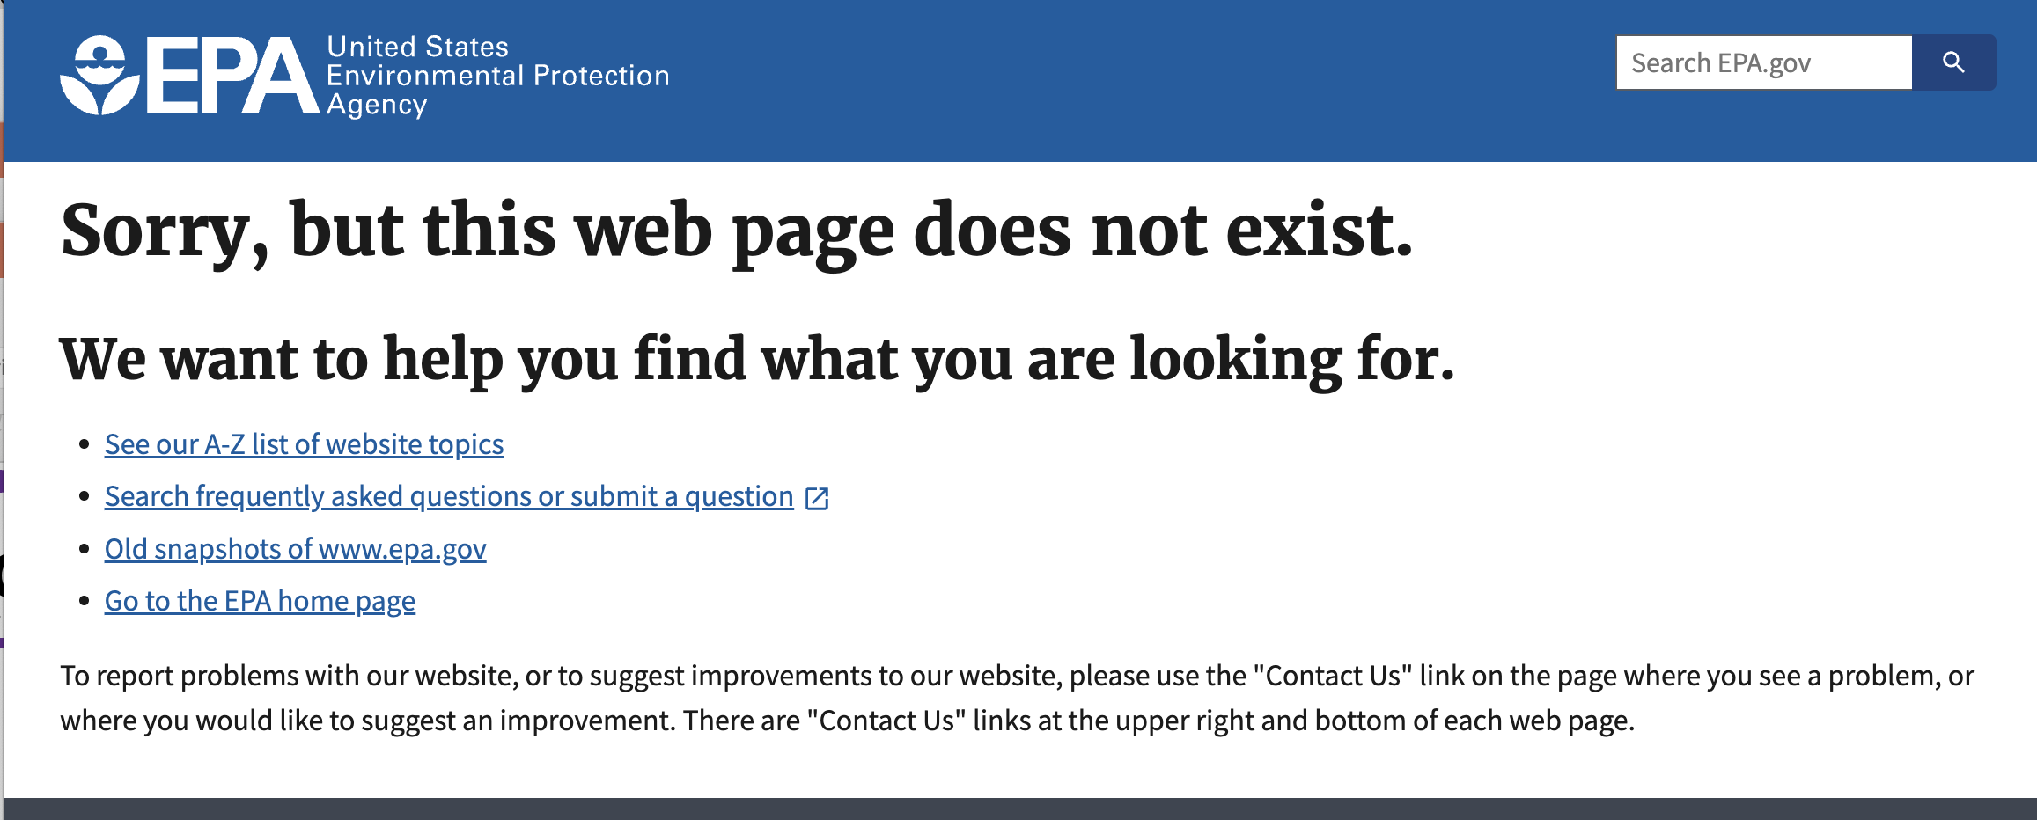
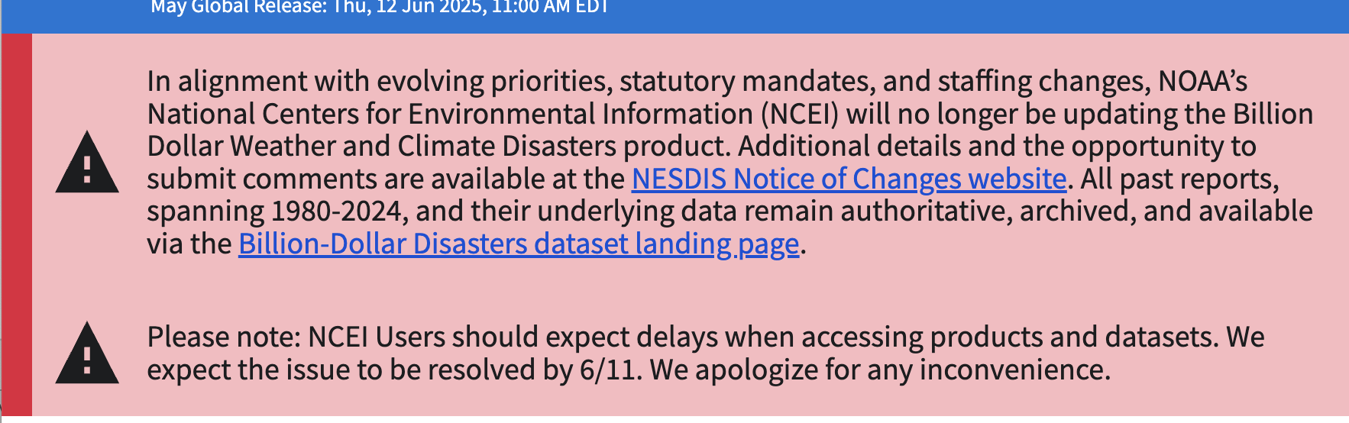
Teaching Tools
Data sources in uncertain times.

Slide 23
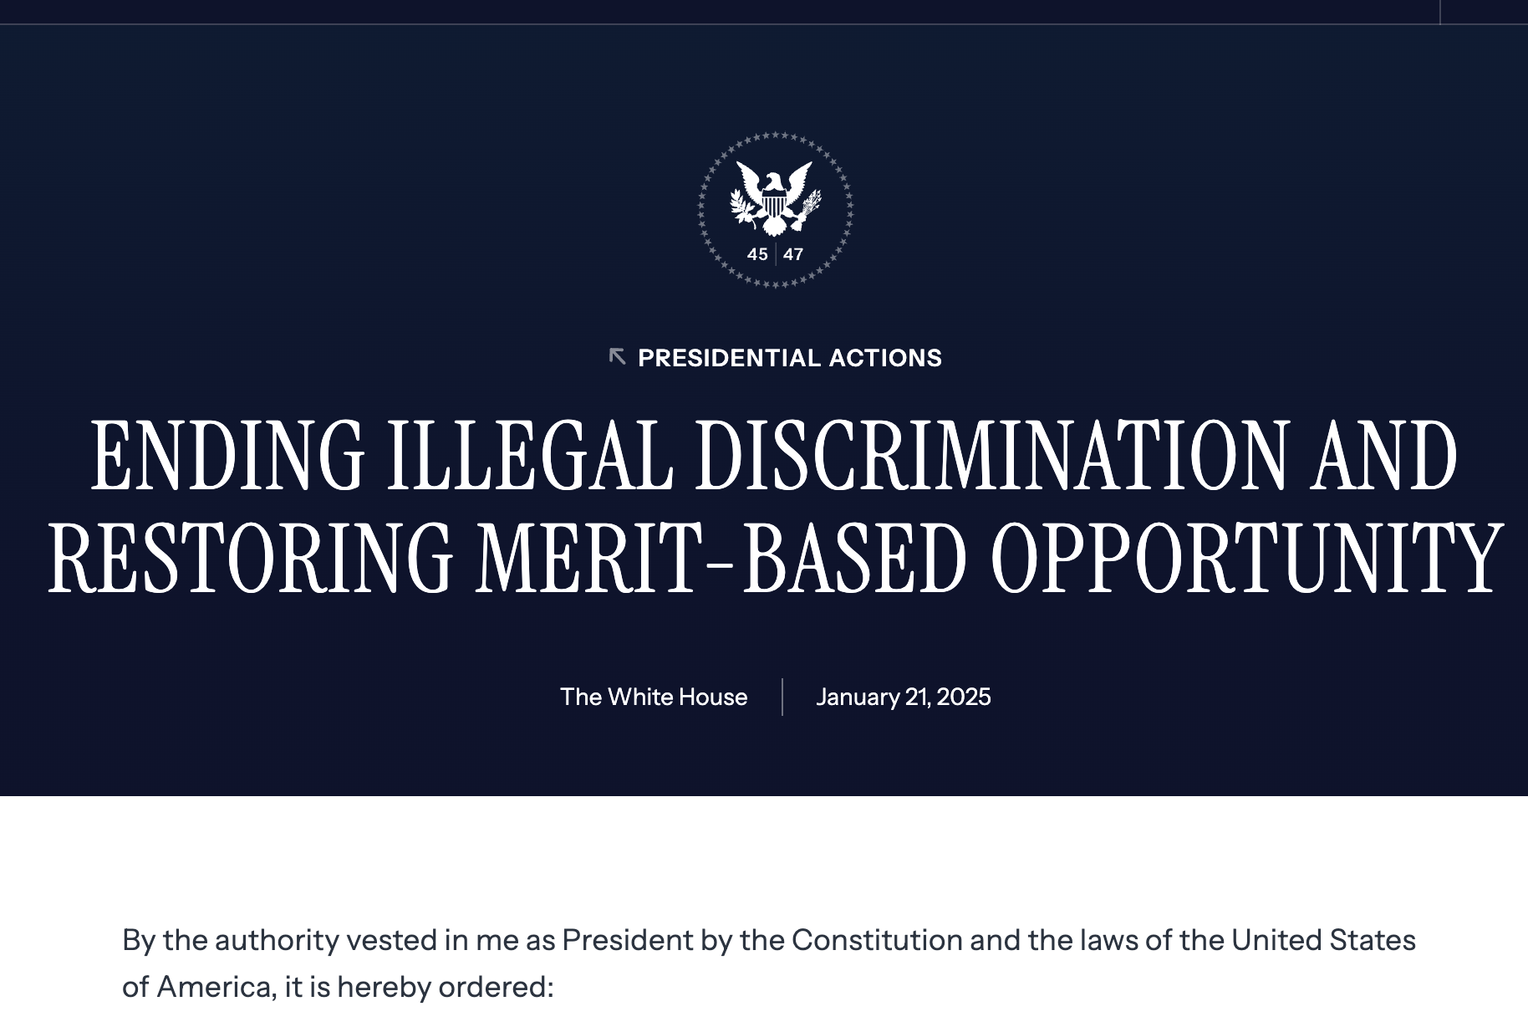
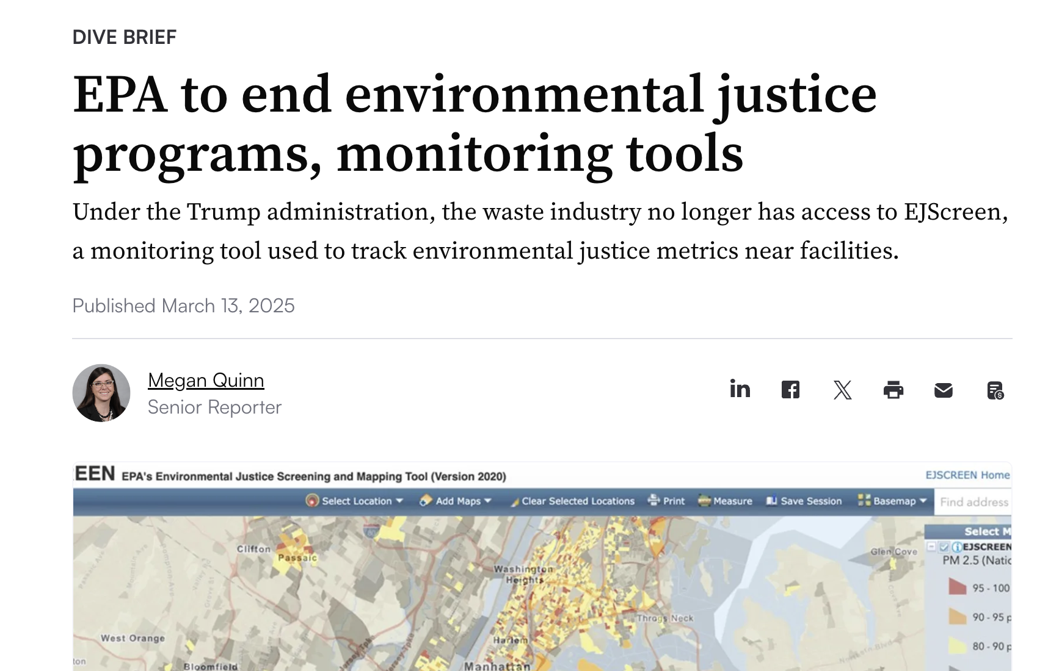
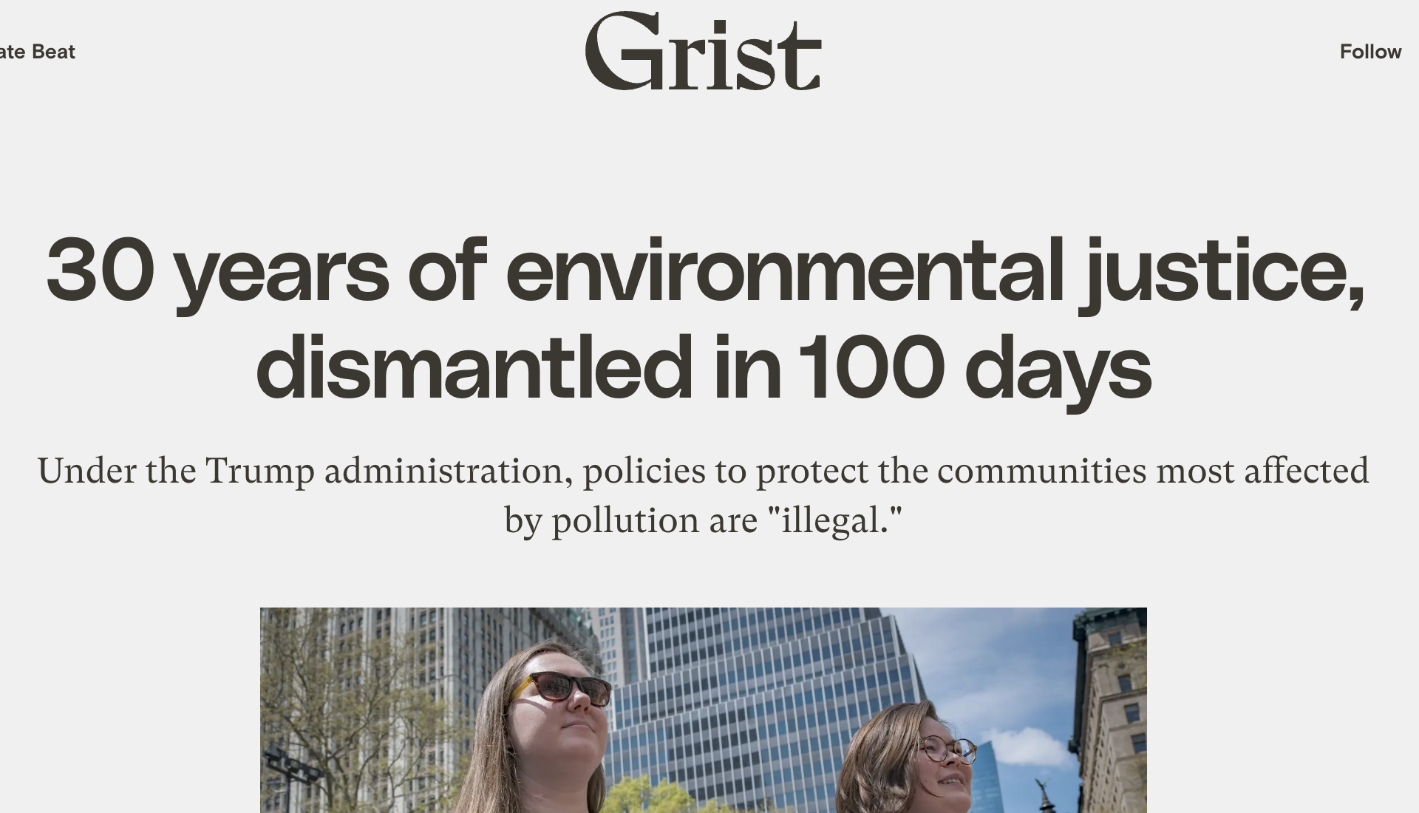
Current Context
Executive Orders ending EO 12898 (1994), 14096 (2023), etc.
Closed U.S. EPA’s Office of EJ & Civil Rights in all 10 regions
Abolished the Department of Justice’s EJ unit
Federal rollbacks/layoffs
Data disappearing
Grants frozen

Slide 24
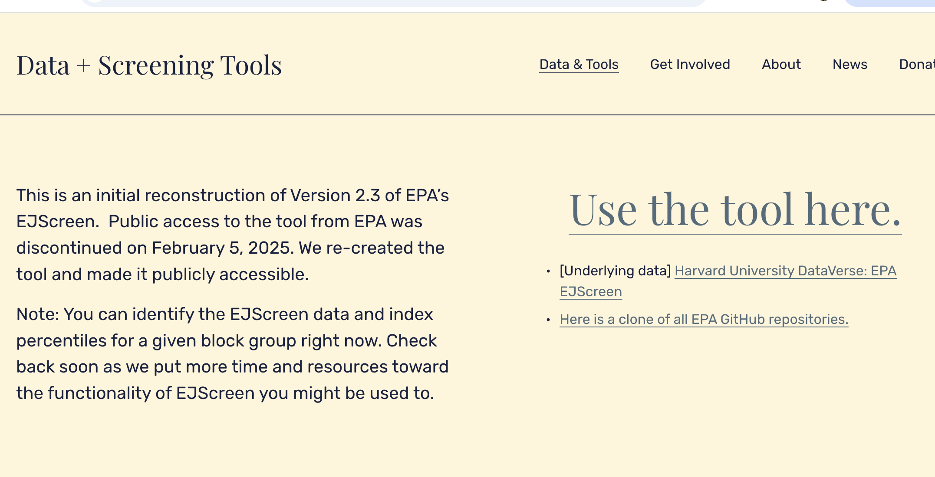
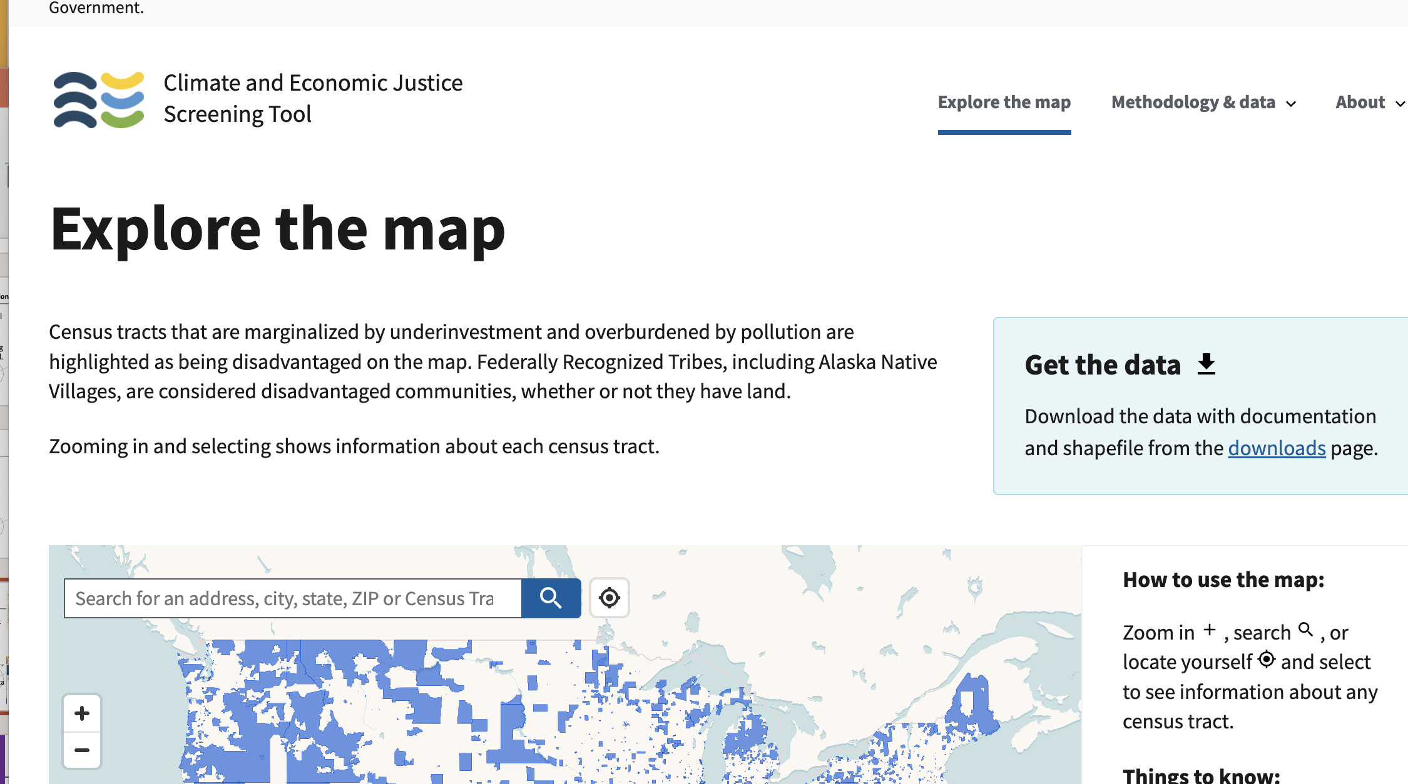
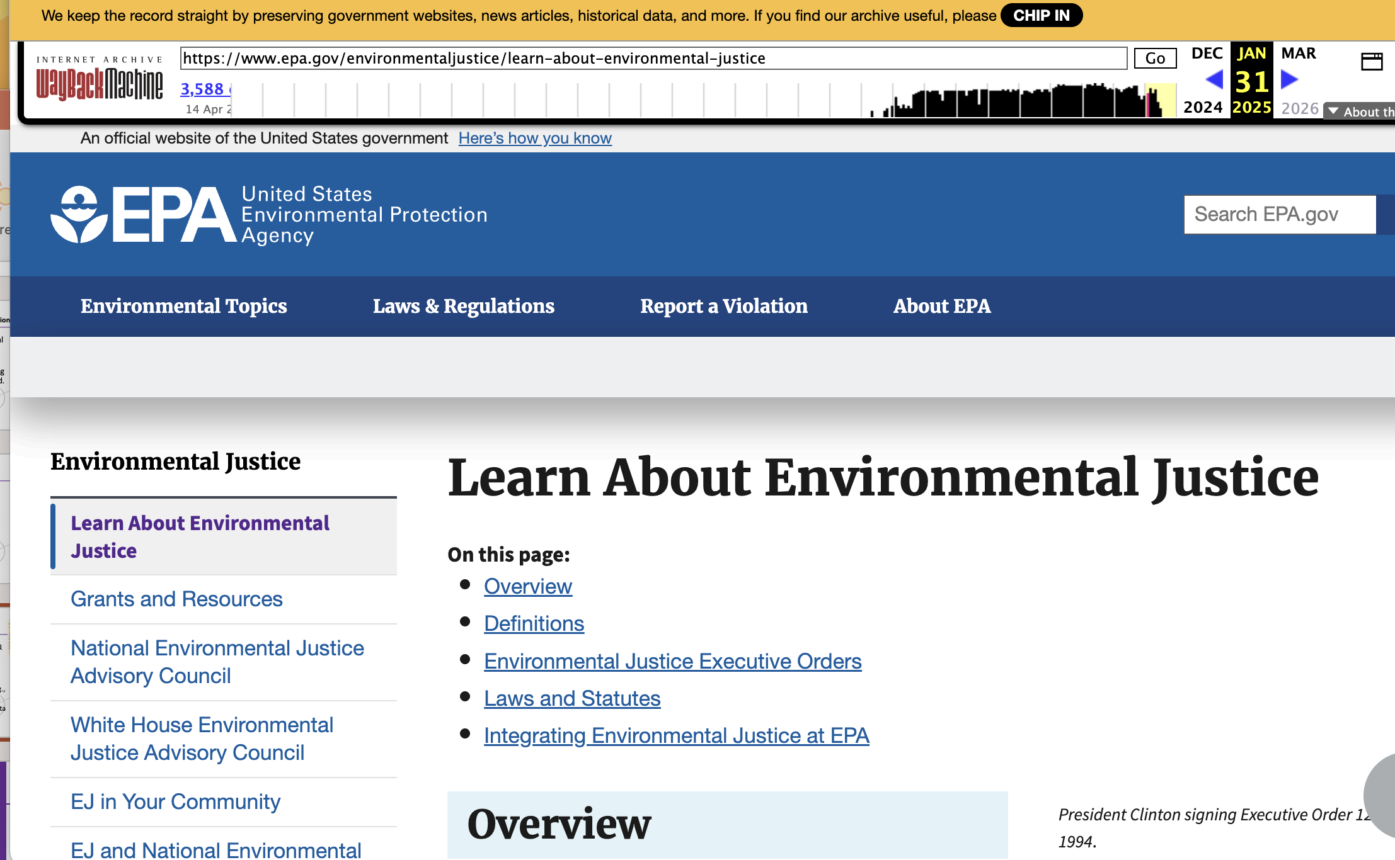
Current 4. Data Source Hunt
` Database
Alternative repositories:
CEQ Climate & Economic Justice Screening Tool
Environmental Data & Governance Initiative
State EJ portals (example CalEnviroScreen).
Strategies: open-source data, community science, FOIA
Teach students adaptive approaches to navigate uncertainty and incomplete data
Crowdsourced & satellite data (NO₂, PM₂.₅). PurpleAir
CJEST
Wayback Machine

Slide 25
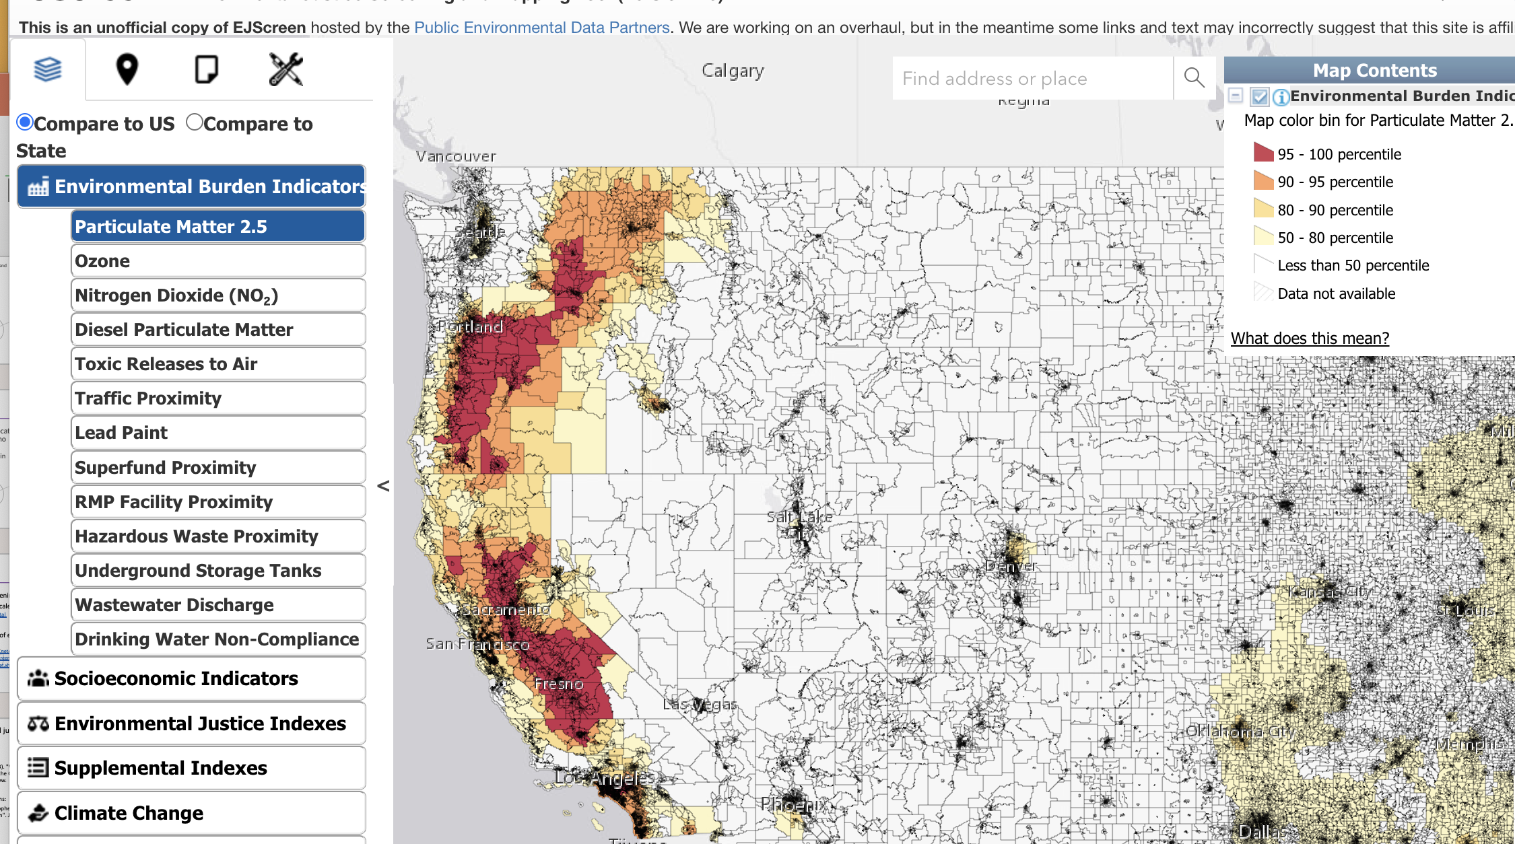
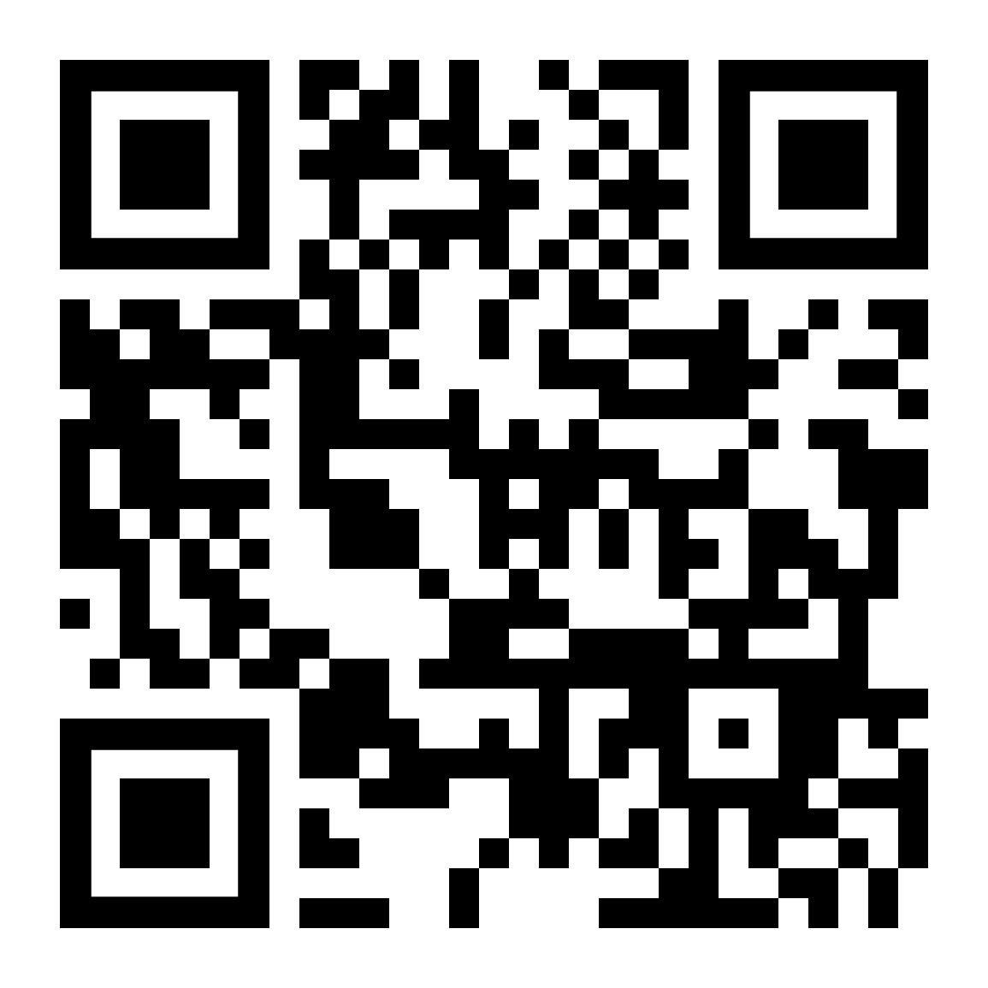
Case Study Mini‑Lab
Small‑group/individual task: interpret an EJScreen output tile for a real neighborhood.

Slide 26
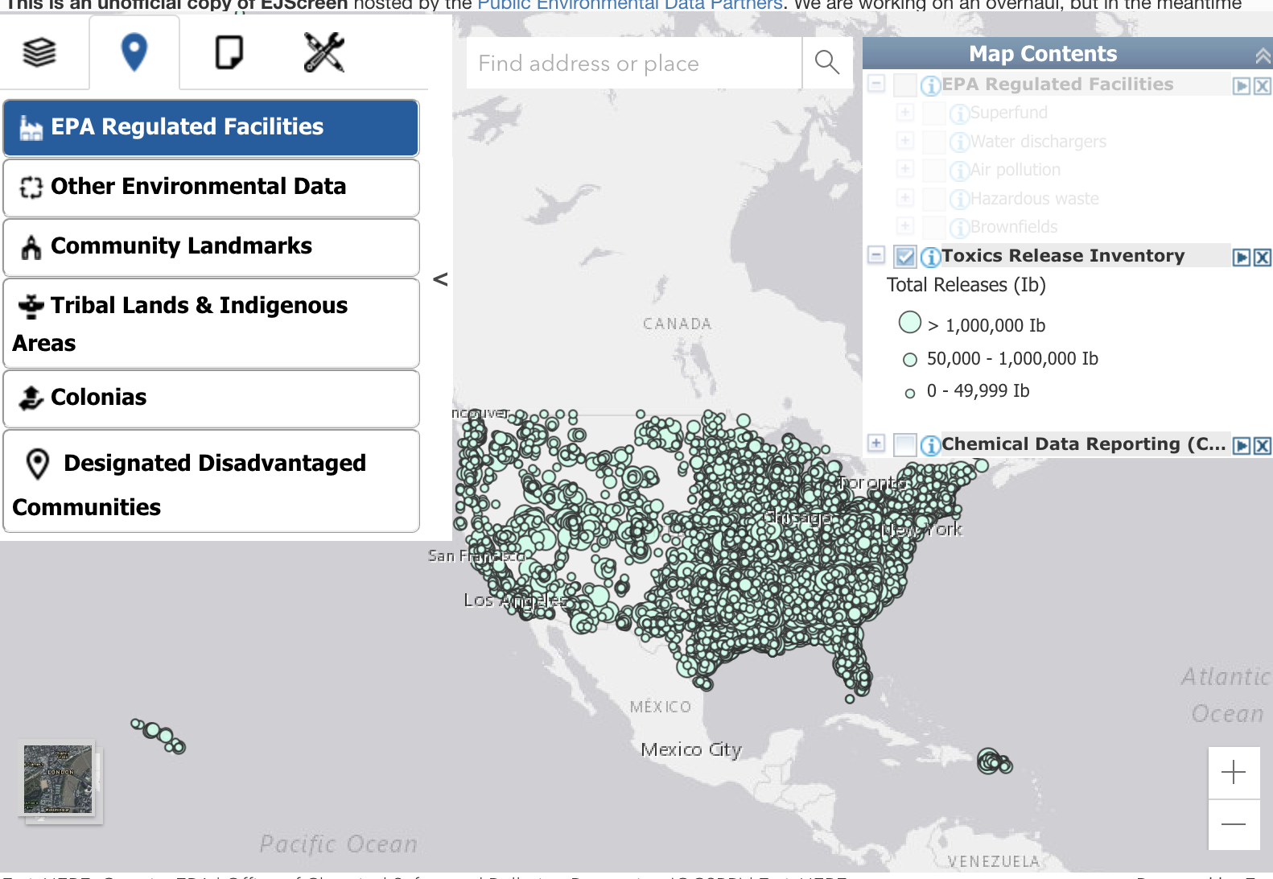
Navigate to your Home County
Find your home (childhood or current)
Add a Map Social Indicators : Choose Low Income, People of Color, or Education
Climate Change: Extreme Heat click on census tract to explore how many days over 90 across years.
Navigate to Places add EPA Regulated Facilities
Explore Regulated Facilitates
Add Toxic Release
Designated Disadvantage Communities (Justice40 & EPA IRA)
Using Tools ( Measure, click Ruler) calculate distance to an EPA Regulated Facilities or TRI

Slide 27
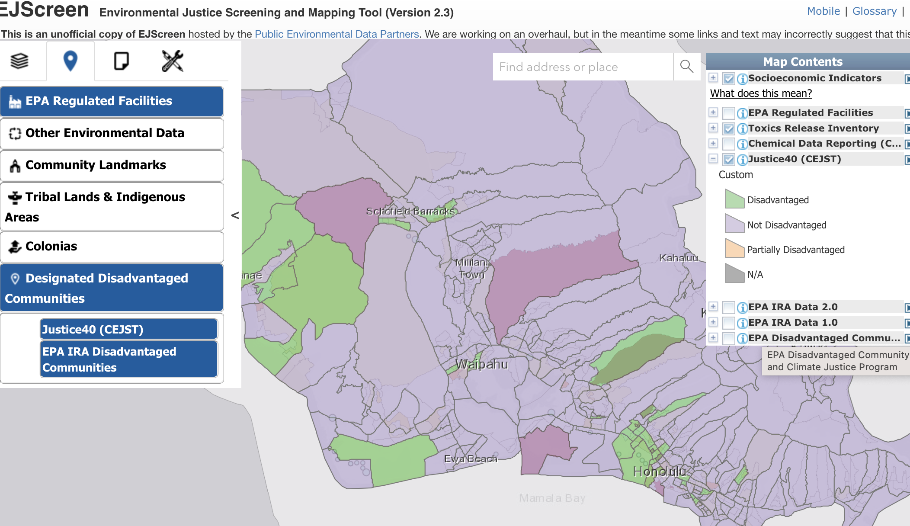
Reflection Questions
Does your local knowledge reflect the data shown for disadvantaged communities? (Did Justice40 or EPA EJ Screen)
Are the scales the same?

Slide 28
Reflection Questions
Was reported hazardous material or TRI closer than you original assumed?

Slide 29
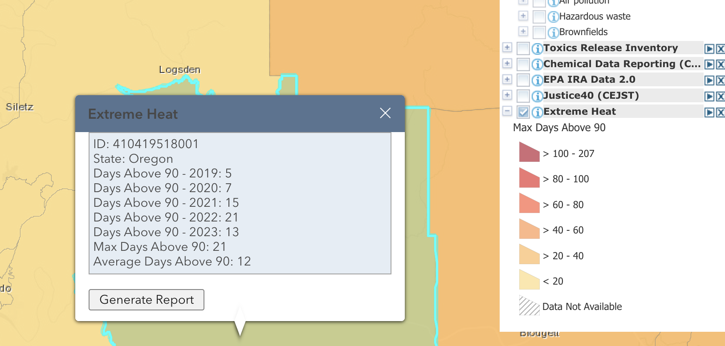
Reflection Questions
Has the number of days above 90 grown in your area?
Compare to nearest Disadvantage Community

Slide 30


Thank you
alowemac@hawaii.edu
http://www2.hawaii.edu/~alowemac/
@iguanalow

